Slide 1
Quantum Leap Engine Proof
Producer/Tech Lead- Taylor Saunders
Programmer – Reese Jones
Lead Designer – Alex Fricke
Designer – Kirthi Velukumar

Slide 2
Goals of the Engine
Tile-based Maps
Graphics
Sound
Simple Physics

Slide 3
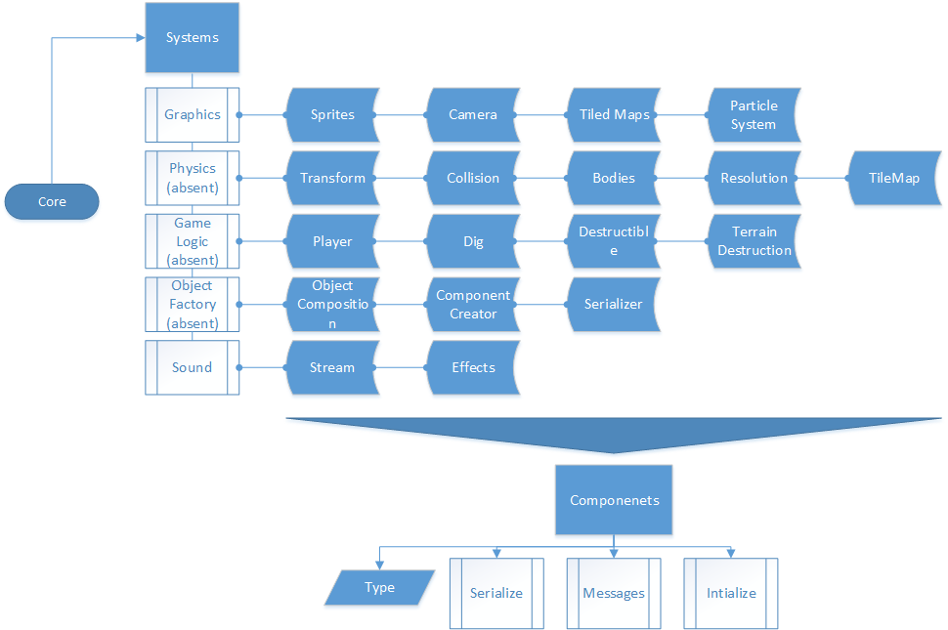
Engine Architecture

Slide 4
Engine Architecture, cont.
Precompiled Header
Using Standard Template Library

Slide 5
Physics
None currently implemented
Basic Collision
Simple Platforming

Slide 6
Cut to our Engine

Slide 7
Debugging Tools
Console window prints out messages
Using asserts
FPS displayed

Slide 8
Graphic Overview
Sprites
Camera
Tiled Maps

Slide 9
Graphics - Sprites
Colorized
Animated
Transformable

Slide 10
Graphics - Camera
Transformable
Resizable

Slide 11
Graphics - Tiled
Artists create
tile set
Design levels
in Tiled
.tmx maps parsed with map loader
Level renderer draws map
on screen

Slide 12
Game Concepts
Digging Game
  Combat
  Exploration
  Platforming
  Setting: post-apocalyptic

Slide 13
Team Structure
Triad
  Simplified for a smaller team
  Producer oversees developer and designer leads
  Developer and design leads oversee their discipline
  Disciplines must work together

Slide 14
Risks and Mitigations
Risk: Physics does not fit mechanics
Mitigation: Reevaluate the physics needed
Risk: Production speed is not up to standards
Mitigation: Isolate and accomplish only what is absolutely necessary.

